Slide 1
Probabilistic Learning – Classification Using Naive Bayes

Slide 2
Naïve Bayes algorithm is a supervised learning algorithm, which is based on Bayes theorem and used for solving classification problems.
It is mainly used in text classification that includes a high-dimensional training dataset.
Naïve Bayes Classifier is one of the simple and most effective Classification algorithms which helps in building the fast machine learning models that can make quick predictions.
It is a probabilistic classifier, which means it predicts on the basis of the probability of an object.

Slide 3

Conditional Probability and bayes theorem
Conditional probability is a measure of the probability of an event occurring, given that another event (by assumption, presumption, assertion or evidence) has already occurred.
If the event of interest is A and the event B is known or assumed to have occurred, "the conditional probability of A given B", or "the probability of A under the condition B", is usually written as P(A|B)
By definition, P(A ∩ B) = P(A|B) * P(B)

Slide 4

Bayes' Theorem:
Bayes' theorem is also known as Bayes' Rule or Bayes' law, which is used to determine the probability of a hypothesis with prior knowledge. It depends on the conditional probability.
The formula for Bayes' theorem is given as:
Where,
P(A|B) is Posterior probability: Probability of hypothesis A on the observed event B.
P(B|A) is Likelihood probability: Probability of the evidence given that the probability of a hypothesis is true.
P(A) is Prior Probability: Probability of hypothesis before observing the evidence.
P(B) is Marginal Probability: Probability of Evidence.

Slide 5
Naïve bayes algorithm does not work directly with numeric data.
One easy and effective solution is to discretize numeric features, which simply means that the numbers are put into categories known as bins. For this reason, discretization is also sometimes called binning.

Slide 6
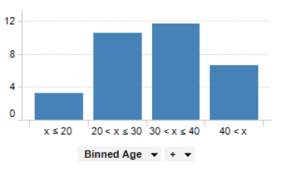

Slide 7
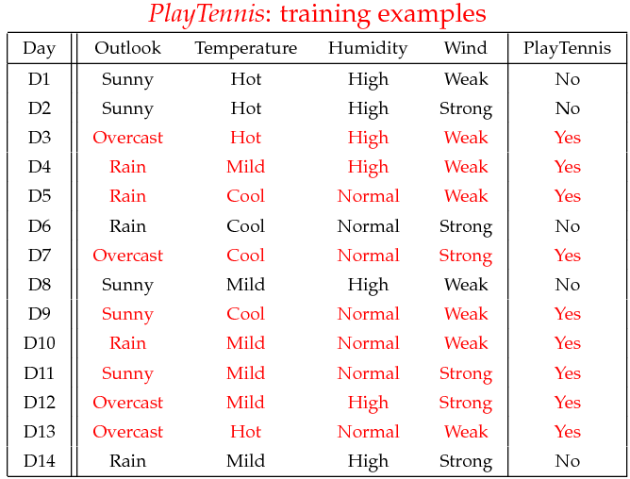
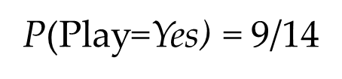
Example
Example: Play Tennis
P(Play=No) = 5/14

Slide 8
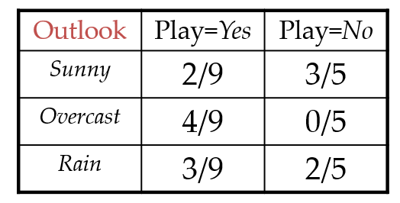
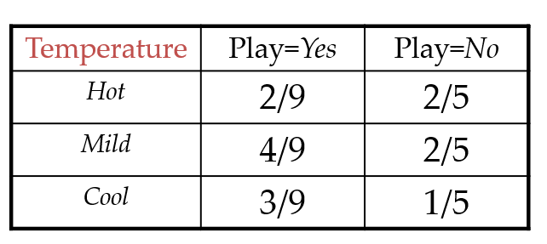

Slide 9
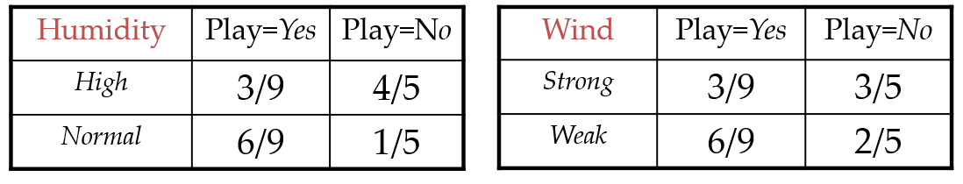

Slide 10
Example
Test Phase
Given a new instance,
x’=(Outlook=Sunny, Temperature=Cool, Humidity=High, Wind=Strong)
Look up tables
P(Outlook=Sunny|Play=Yes) = 2/9
P(Temperature=Cool|Play=Yes) = 3/9
P(Huminity=High|Play=Yes) = 3/9
P(Wind=Strong|Play=Yes) = 3/9
P(Play=Yes) = 9/14
P(Outlook=Sunny|Play=No) = 3/5
P(Temperature=Cool|Play==No) = 1/5
P(Huminity=High|Play=No) = 4/5
P(Wind=Strong|Play=No) = 3/5
P(Play=No) = 5/14
P(Yes|x’): [P(Sunny|Yes)P(Cool|Yes)P(High|Yes)P(Strong|Yes)]P(Play=Yes) = 0.0053
P(No|x’): [P(Sunny|No) P(Cool|No)P(High|No)P(Strong|No)]P(Play=No) = 0.0206
Given the fact P(Yes|x’) < P(No|x’), we label x’ to be “No”.

